Slide 1
Sugarcane crop and soil analysis
Group 08

Slide 2
MOTIVATION
Presented by - <Name Here>
Planning for Finances, Insurance, Work force & Logistic requires some estimation about yield
Traditional approaches can be supported with more statistical approach
Yield Prediction
Difficulties in monitoring crop health for a large area is resource consuming and inefficient
When potential disease or issue is identified, it is too late
Crop Health
Monitoring
Acquiring new land for sugarcane farming requires soil study to measure nutrient levels in the soil
It is costly, resource consuming & often inaccurate in nature.
Soil Suitability
Evaluation

Slide 3
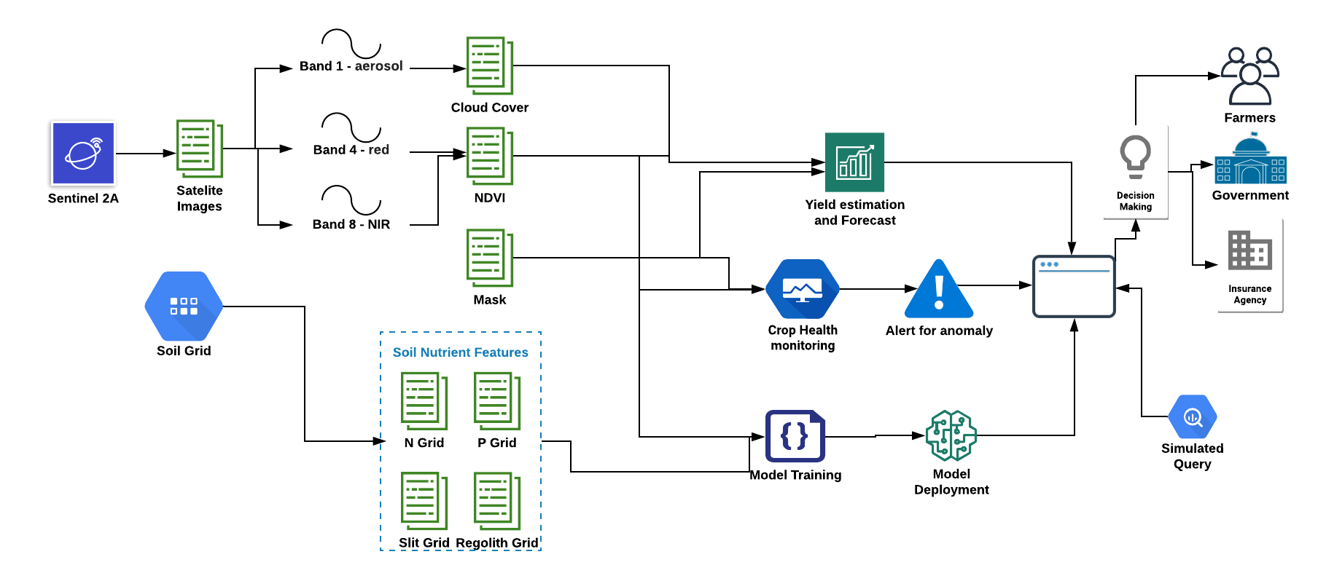
High Level System Architecture
Presented by - <Name Here>

Slide 4
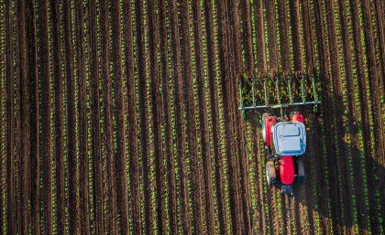
Yield Prediction
Presented by - <Name Here>
Predicting the crop yield is an important aspect from the farmers perspective. There are some stakeholders who are impacted by the yield prediction. These include farmers, banks and industry stakeholders.
Farmers get impacted majorly by the amount of yield produced each year. It helps them plan for rainwater harvesting, fertilizer and pesticide management as well as planning for finances.
We have used a forecasting model to predict the yield which will eventually benefit the farmers. In order to calculate the yield, we have considered the harvested area from the satellite image along with the crop density.
Getting a rough estimate about the yield can encourage both small and large farmers to implement strategies and techniques like planting commercial hybrids, better pesticides and irrigation techniques to establish a better yield.

Slide 5
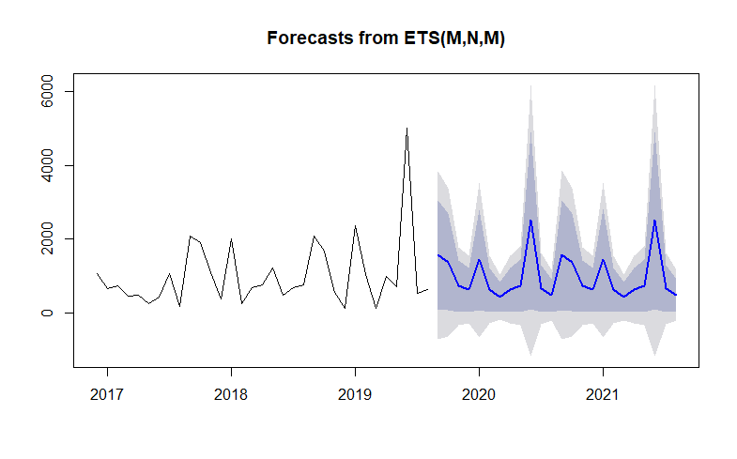
Yield Prediction
Presented by - <Name Here>

Slide 6
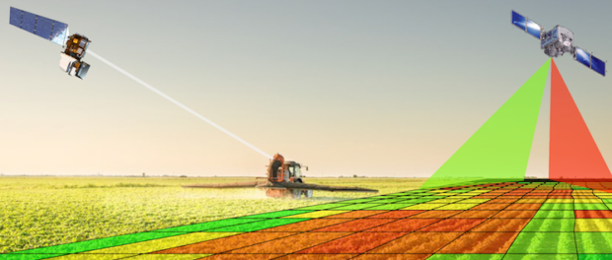
Crop Health Monitoring
Presented by - <Name Here>
Industrial sugarcane farms are generally occupy a large area.
It is really hard for farmers to monitor crop health through entire plantation due to large area.
Satellite imagery is readily available and also has a high frequency due to many organizations like planet have capabilities to image entire earth every day using Nano satellites in high resolution.
High resolution & frequency as well as readily available ways and proven algorithms makes Satellite Images an ideal resource to monitor crop health.

Slide 7
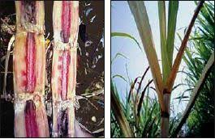
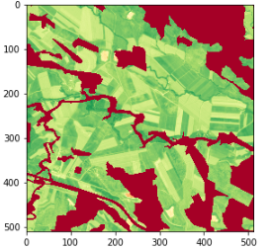
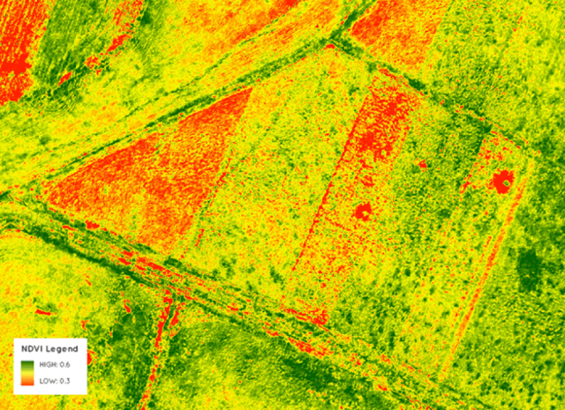
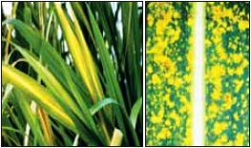
Crop Health Monitoring
Presented by - <Name Here>
Sugarcane Disease
NDVI Image
Abnormal NDVI Reading

Slide 8
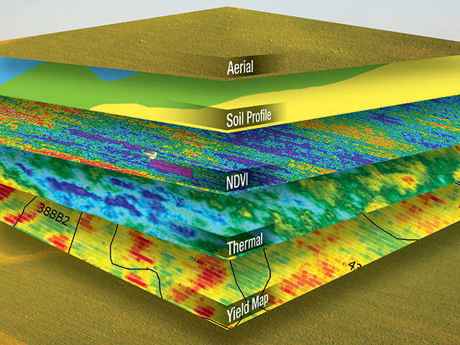
Soil Suitability Evaluation
Presented by - <Name Here>
Industrial sugarcane farms are generally occupy a large area.
It is really hard for farmers to monitor crop health through entire plantation due to large area.
Satellite imagery is readily available and also has a high frequency due to many organizations like planet have capabilities to image entire earth every day using Nano satellites in high resolution.
High resolution & frequency as well as readily available ways and proven algorithms makes Satellite Images an ideal resource to monitor crop health.

Slide 9
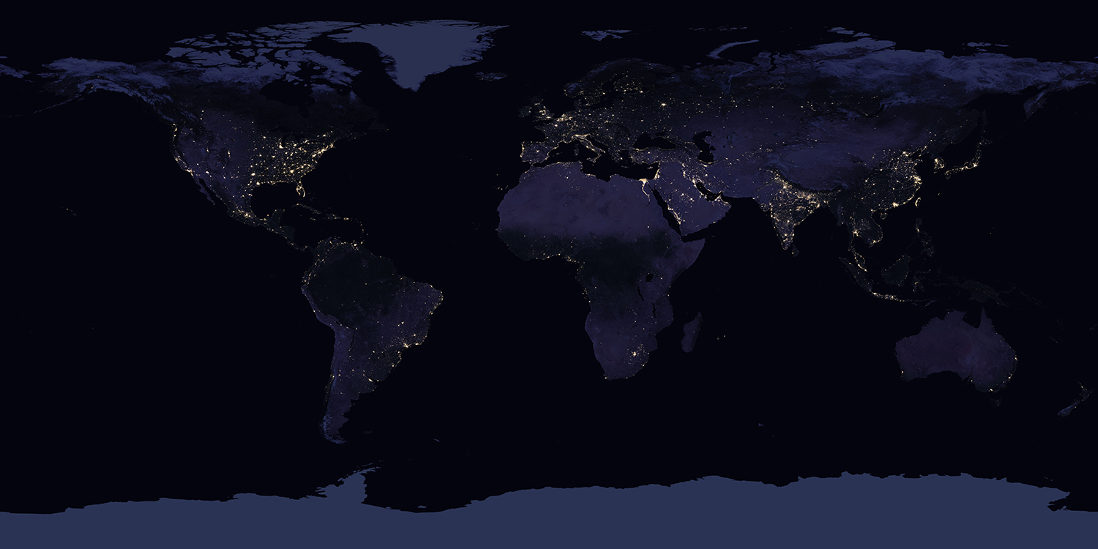
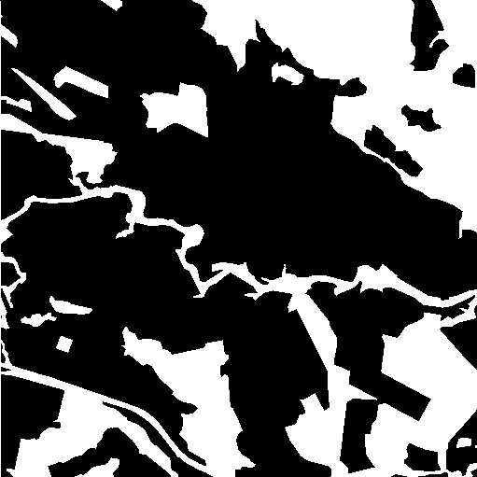

Soil Suitability Evaluation
Presented by - <Name Here>
Binary Classification
Features Soil Nutrients Grid
Training Data Labels - Mask
Predicted soil classified as suitable

Slide 10
Thank you

